Slide 1
Chapter 5 Interaction Design and HCI in the Software Process
What is Design?
What are the design processes?
Who are the users?
Scenarios
How to navigate around the system.
How to develop iterations and Prototypes.

Slide 2
Interaction design basics
Design:
what it is interventions, goals, constraints
The design process
what happens when
Users
who they are, what they are like?
Scenarios
rich stories of design
Navigation
finding your way around a system
Iteration and prototypes
never get it right first time!

Slide 3
Interactions and interventions
Design interactions not just interfaces, not just the immediate interaction.
e.g. stapler in office – technology changes interaction style
manual: write, print, staple, write, print, staple, …
electric: write, print, write, print, …, staple
Designing interventions not just artefacts, not just the system, but also …
documentation, manuals, tutorials
what we say and do as well as what we make

Slide 4
What is design?
Design is achieving goals within constraints.
goals - purpose
who is it for, why do they want it.
constraints
materials, platforms
trade-offs
Choosing which goals or constraints can be relaxed so that others can be met.

Slide 5
Golden rule of design Understand your materials
understand computers
limitations, capacities, tools, platforms
understand people
psychological, social aspects
human error
and their interaction …

Slide 6
The process of design
scenarios task analysis
what is wanted
guidelines
principles
analysis
interviews
ethnography
what is there
vs.
what is wanted
precise specification
design
dialogue notations
implement
and deploy
evaluation
heuristics
prototype
architectures
documentation
help

Slide 7
Steps
Requirements
what is there and what is wanted …
Analysis
ordering and understanding
Design
how to decide
Iteration and prototyping
getting it right and finding what is really needed!
Implementation and deployment
making it and getting it out there

Slide 8
Know your user
who are they?
probably not like you!
talk to them
watch them
use your imagination

Slide 9
Scenarios
Stories for design
communicate with others
validate other models
understand dynamics
What will users want to do?
Step-by-step walkthrough
what can they see (sketches, screen shots)
what do they do (keyboard, mouse etc.)
what are they thinking?
Use and reuse throughout design

Slide 10
Explore the depths
Explore interaction
what happens when
Explore cognition
what are the users thinking
Explore architecture
what is happening inside

Slide 11
Use scenarios to:
Communicate with others
designers, clients, users
Validate other models
‘play’ it against other models
Express dynamics
screenshots – appearance
scenario – behaviour

Slide 12
navigation design
the systems
info and help
management
messages
start
add user
remove user
global structure – whole site
local structure – single screen
main
screen
remove
user
confirm
add user

Slide 13
Levels
widget choice
menus, buttons etc.
screen design
application navigation design
environment
other apps, O/S

Slide 14
the web …
widget choice
screen design
navigation design
environment
elements and tags
<a href=“...”>
page design
site structure
the web, browser, external links

Slide 15
Physical devices
widget choice
screen design
navigation design
environment
controls
buttons, knobs, dials
physical layout
modes of device
the real world

Slide 16
Think about structure
Within a screen
later ...
Local
looking from one screen or page out
Global
structure of site, movement between screens
Wider still
relationship with other applications

Slide 17
Four things to look for when looking at a single web page, screen or state of a device
knowing where you are
knowing what you can do
knowing where you are going
or what will happen
knowing where you’ve been
or what you’ve done

Slide 18
Global hierarchical diagrams
the system
info and help
management
messages
add user
remove user

Slide 19
hierarchical diagrams ctd.
Parts of application
screens or groups of screens
Typically functional separation
the systems
info and help
management
messages
add user
remove user

Slide 20
Network diagrams
What leads to what
What happens when
Including branches
More task oriented then hierarchy
main
screen
remove
user
confirm
add user

Slide 21
wider still …
Style issues:
platform standards, consistency
Functional issues
cut and paste
Navigation issues
embedded applications
links to other apps … the web

Slide 22
iteration and prototyping prototyping
you never get it right first time
if at first you don’t succeed …
OK?
design
prototype
evaluate
done!
re-design

Slide 23
Why Prototype?
Get feedback earlier
Cheaper to Experiment with alternatives
Easer to change or throw away

Slide 24
Fidelity
how similar the prototype is to the finished interface.
Low-fidelity prototypes omit details
High-fidelity prototypes are very similar to the finished product.
Fidelity is Multidimensional
Breadth refers to the fraction of the feature set represented by the prototype.
A prototype that is low-fidelity in breadth might be missing many features.
A word processor prototype might omit printing and spell-checking, for example.
Depth refers to how deeply each feature is implemented.
Low-fidelity in depth may mean limited choices, canned responses, or lack of robustness and error handling.

Slide 25
Paper prototypes
Excellent choice for early design iterations, mostly made of paper.
usually hand-sketched on multiple pieces, with different pieces showing different menus, dialog boxes, or window elements.
The key difference between mere sketches and a paper prototype is interactivity.
A person simulates the computers operation
Putting down & picking up pieces
Writing responses on the screen
Describing effects that are hard to show on paper
A paper prototype is low fidelity in both look and feel.
high fidelity in breadth at very little cost

Slide 26
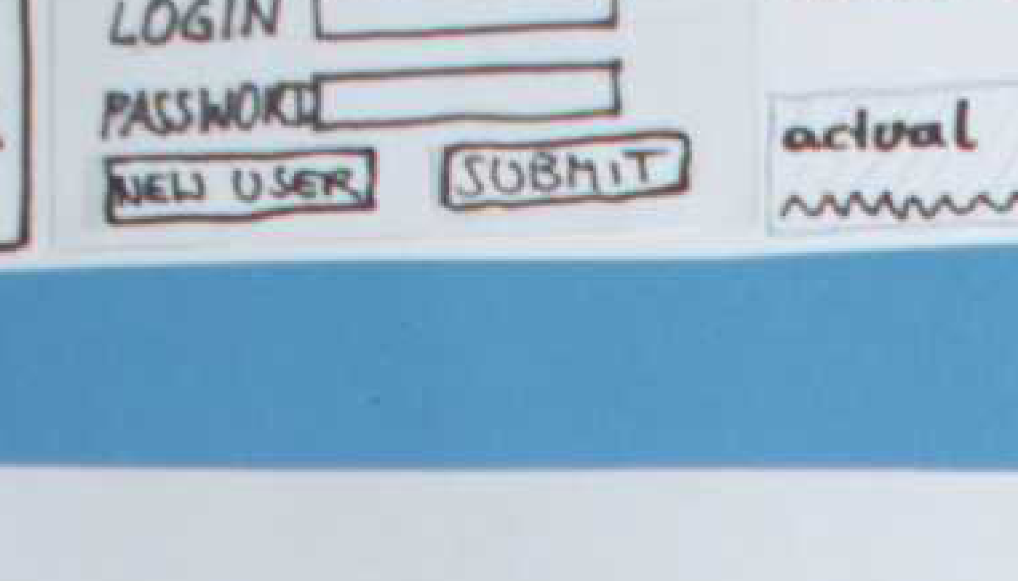
Why paper prototypes?
Hand-sketching on paper is faster.
Sketching is faster than programming
Paper is easy to change.
Focuses attention on big picture
Designer doesn't waste time on detail
Customer makes more creative suggestions, not nitpicking
No special skills are required.
graphic designers, usability specialists, and even users can help create prototypes and operate them.

Slide 27
Tips for Good Paper Prototypes
A paper prototype should be larger
Use a single color.
don’t render every visual effect in paper.
Replace tricky visual feedback with audio descriptions
Tooltips, drag & drop, animation, progress bar
Keep pieces organized
Use fodders & open envelopes

Slide 28
What You Can Learn from a Paper Prototype
Conceptual model
Do users understand it?
Functionality
Does it do what is needed?
Missing features?
Navigation & task flow
Can users find their way around?
Are information preconditions met?
Terminology
Do users understand labels?
Screen contents
What needs to go on the screen?

Slide 29
What You Can’t Learn
Look: color, font, white space, etc
Feel: Fitts’s Law issues
Response time
Are small changes noticed?
Even the tiniest change to a paper prototype is clearly visible to user
Exploration vs. deliberation
Users are more deliberate with a paper prototype; they don't explore or thrash as much

Slide 30
Computer Prototype
Interactive software simulation
High-fidelity in look & feel
Low-fidelity in depth
Paper prototype had a human simulating the backend; computer prototype doesn’t
Computer prototype is typically horizontal:
covers most features, but no backend

Slide 31
What You Can Learn From Computer Prototypes
Everything you learn from a paper prototype, plus:
Screen layout
Is it clear, overwhelming, distracting, complicated?
Can users find important elements?
Colors, fonts, icons, other elements
Well-chosen?
Interactive feedback
Do users notice & respond to status bar messages, cursor changes, other feedback
Fitts’s Law issues
Controls big enough? Too close together? Scrolling list is too long?

Slide 32
HCI in the software process The software lifecycle
Software engineering is the discipline for understanding the software design process, or life cycle
Designing for usability occurs at all stages of the life cycle, not as a single isolated activity

Slide 33
The waterfall model
Requirements specification
Architectural design
Detailed design
Coding and unit testing
Integration and testing
Operation and maintenance

Slide 34
Activities in the life cycle
Requirements specification
designer and customer try capture what the system is expected to provide can be expressed in natural language or more precise languages, such as a task analysis would provide
Architectural design
High-level description of how the system will provide the services required factor system into major components of the system and how they are interrelated needs to satisfy both functional and nonfunctional requirements
Detailed design
Refinement of architectural components and interrelations to identify modules to be implemented separately the refinement is governed by the nonfunctional requirements

Slide 35
Verification and validation
Verification
designing the product right
Validation
designing the right product
The formality gap
validation will always rely to some extent on subjective means of proof
Management and contractual issues
design in commercial and legal contexts
Real-world requirements and constraints
The formality gap

Slide 36
The life cycle for interactive systems
cannot assume a linear sequence of activities as in the waterfall model
lots of feedback!
Requirements specification
Architectural design
Detailed design
Coding and unit testing
Integration and testing
Operation and maintenance

Slide 37
Iterative design and prototyping
Iterative design overcomes inherent problems of incomplete requirements.
Prototypes
simulate or animate some features of intended system
different types of prototypes
throw-away
incremental
evolutionary
Management issues
time
planning
non-functional features
contracts

Slide 38
Techniques for prototyping
Storyboards: need not be computer-based can be animated
Limited functionality simulations
some part of system functionality provided by designers
tools like HyperCard are common for these Wizard of Oz technique
Warning about iterative design
design inertia – early bad decisions stay bad diagnosing real usability problems in prototypes…. and not just the symptoms

Slide 39
Design rationale
Design rationale is information that explains why a computer system is the way it is.
Benefits of design rationale:
communication throughout life cycle
reuse of design knowledge across products
enforces design discipline
presents arguments for design trade-offs
organizes potentially large design space
capturing contextual information

Slide 40
Design rationale (cont’d)
Types of DR:
Process-oriented
preserves order of deliberation and decision-making
Structure-oriented
emphasizes post hoc structuring of considered design alternatives
Two examples:
Issue-based information system (IBIS)
Design space analysis

Slide 41
Issue-based information system (IBIS)
basis for much of design rationale research
process-oriented
main elements:
Issues
– hierarchical structure with one ‘root’ issue
Positions
– potential resolutions of an issue
Arguments
– modify the relationship between positions and issues
gIBIS is a graphical version

Slide 42
structure of gIBIS
supports
Position
Argument
responds to
Issue
responds to
Position
objects to
Argument
specializes
Sub-issue
generalizes
questions
Sub-issue
Sub-issue

Slide 43
Design space analysis
structure-oriented
QOC – hierarchical structure:
questions (and sub-questions)
– represent major issues of a design
options
– provide alternative solutions to the question
criteria
– the means to assess the options in order to make a choice

Slide 44
the QOC notation
Criterion
Option
Question
Option
Criterion
Option
Criterion
…
Consequent Question
…
Question

Slide 45
Psychological design rationale
to support task-artefact cycle in which user tasks are affected by the systems they use
aims to make explicit consequences of design for users
designers identify tasks system will support
scenarios are suggested to test task
users are observed on system
psychological claims of system made explicit
negative aspects of design can be used to improve next iteration of design

Slide 46
Thank you!

